Slide 1





Scientific Visualization and Reproducibility for Open Environmental Science http://blogs.evergreen.edu/vistas
Judith B. Cushing Computer Science The Evergreen State College Olympia WA, USA judyc@evergreen.edu
Denise Lach and Chad Zanocco School of Public Policy Oregon State University Corvallis OR, USA Denise.lach@oregonstate.edu zanoccoc@oregonstate.edu
Jonathan Halama Environmental Science Oregon State University halamaj@oregonstate.edu
Acknowledgements VISTAS team: Nik Stevenson-Molnar & Ken Ferschweiler (Conservation Biology Inst.) Mike Bailey & Kirstsen Winters (OSU), Susan Stafford (Univ. Minnesota) VISTAS collaborators : Bob McKane & Allen Brookes (EPA), John Bolte, Christoph Thomas, & Dominique Bachelet (OSU) Funding: NSF:ABI-BIO 10-62572, S&CC-IIS-CISE 16-37334
Presented at the 3rd Annual Workshop Open Science in Big Data https://osbd.github.io/ IEEE Big Data 2018, December 10, 2018, Seattle WA

Slide 2
Scientific Visualization and Reproducibility for ecological studies of topographically complex landscapes
Textbook reproducibility for complex ecological systems ???
Consider instead triangulation for replication ….
3D Terrain Visualization is useful for model validation
Model validation is analogous to triangulation, so 3D Terrain Visualization might also be useful for triangulation
Needed to confirm our hypothesis: the “right” visualization software

Slide 3
Reproducibility for ecological systems ???
Reproducibility [Peng]: data sets & s/w must be available for verifying published results
BUT
for complex ecological systems?
Replication [Peng]: generate scientific findings using independent investigators, methods & data
BUT
HOW?

Slide 4
Triangulation as a Replication Strategy for Complex Ecological Systems
Triangulation [Munafo]:
Use multiple approaches to address one question
“recognize” the same robust effect in different studies --
abductive vs deductive reasoning
--
likely explanations vs.
statistically significant studies centered on an endpoint that supports a hypothesis

Slide 5
3D Terrain Visualization Visualization of Terrestrial and Aquatic Systems
Topography matters! The effects of complex topography over time
on ecological processes is
poorly understood & difficult to study
CS research : co-develop a proof of concept: VISTAS
Environmental science (ES) : conduct research w/ VISTAS
Social science : study of co-development & use in ES

Slide 6
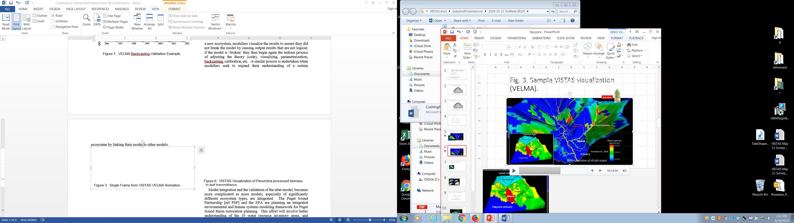
Scientists use 3D Terrain Visualization to Validate Environmental Science Predictive Models
Build the model
Visualize it
Revise Model

Slide 7
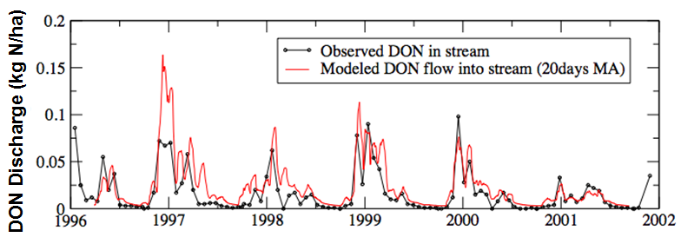
Scientists use 3D Terrain Visualization to Validate Environmental Science Predictive Models
Build the model
Visualize it
Revise Model
.
.
.
.
.
Validate model statistically
(traditional backcasting)

Slide 8
Scientists also use Terrain Visualization to Integrate ES Models
Link models M1, M2, step by step
Visualize their output
Revise M1 or M2
.
.
Validate M1 & M2 again
(traditional backcasting)

Slide 9
Is Model Validation ~ Triangulation?
What if: instead of multiple models
Different studies over the same landscape
Multiple approaches to one question or multiple studies to corroborate the same or similar effects
abductive reasoning, likely explanations If visualization suggests corroboration, then
robust (more difficult) computational approach….
Visualization – one tool for replication

Slide 10
What visualization needed for replication?
Everything VISTAS does…..
Given:
gridded data of one or more features, lat/long & resolution
VISTAS will
Generate a “3D” map
Drape the feature(s) across the landscape
View several variables on maps side by side or overlapping
Generate simple statistics
Our collaborators can then (easily and quickly)
View & explore data
over time—animation
over space—flythrough
over data—inspect, filter
Annotate the map with 2D graphs and some statistics
Label the map
Save the project
Export visualizations
Plus…

Slide 11
What Visualization for Replication?
Increased analytical capability
Interactive landscape shifting to align maps
Scale scenes independently
Accommodate other sub-domains
More kinds of input data
New visualization types

Slide 12
What Visualization for Replication?
Increased analytical capability
Interactive landscape shifting to align maps
Scale scenes independently
Accommodate other sub-domains
More kinds of input data
New visualization types
Staying power across platforms, O/S releases….
Why not general-purpose vis s/w (ParaView, VTK…)?
[Heer] Model UI actions in a domain-specific language,
Then decouple the UI from the underlying runtime

Slide 13
Scientific Visualization and Reproducibility for ecological studies of topographically complex landscapes
Textbook reproducibility for complex ecological systems ?
Consider instead triangulation for replication
3D Terrain Visualization is useful for model validation
Triangulation is analogous to model validation, so….
To confirm our hypothesis:
The “right” visualization software!
Demonstration: ecologist(s) using visualization for replication…
Open data as well as software….

Slide 14
Questions? Discussion? Suggestions?

Slide 17
Contact Us Visualization of Terrestrial & Aquatic Systems Exploring data on topographically complex landscapes http://blogs.evergreen.edu/vistas
Chad Zanocco Denise Lach Oregon State University zanoccoc@oregonstate.edu Denise.lach@oregonstate.edu
Nik Molnar, Ken Ferschweiler Conservation Biology Inst. nik.molnar@consbio.org ken@consbio.org
Judith B. Cushing The Evergreen State College judyc@evergreen.edu
NSF ABI-BIO 10-62572,

Slide 18
Try VISTAS… http://blogs.evergreen.edu/vistas/
some experience with GIS software will be helpful….
At …vistas/vistas-software you will find:
VISTAS Introduction (these slides +)
How to download VISTAS EXE & sample files
User documentation
Quickstart manuals
How to videos
Developer documentation
Links to freely available source files

Slide 19
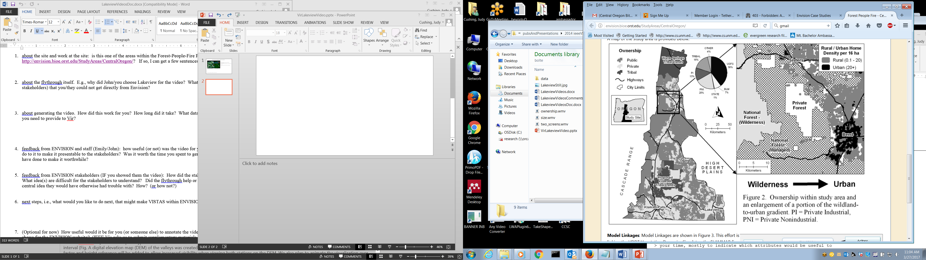
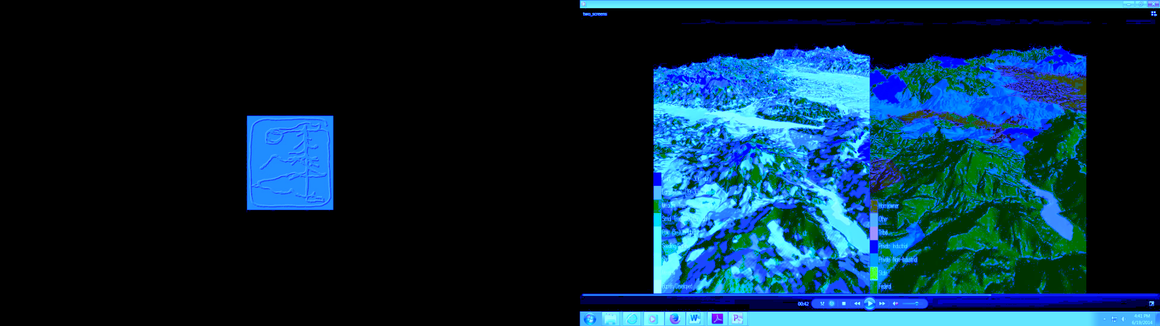
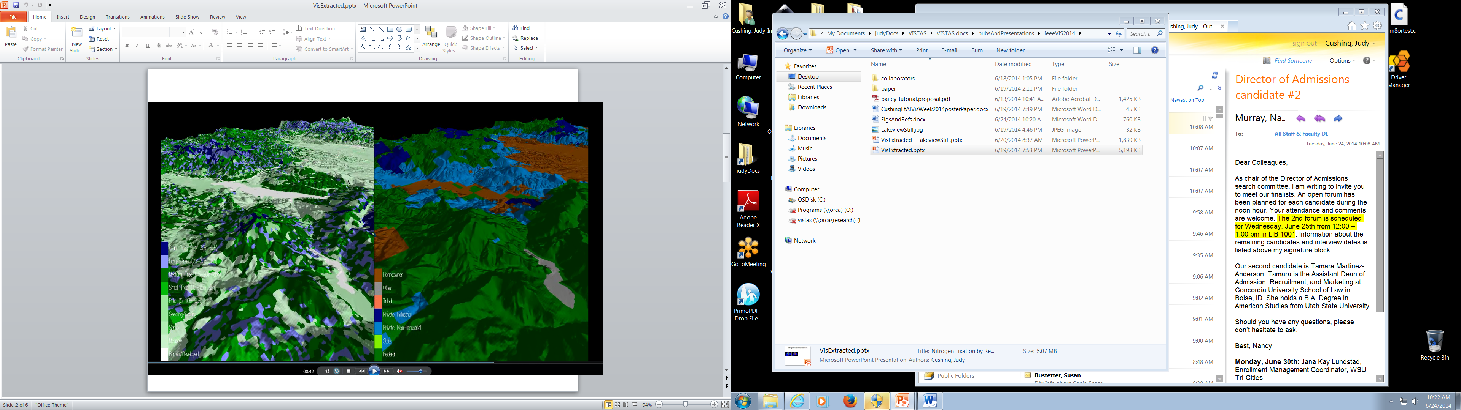
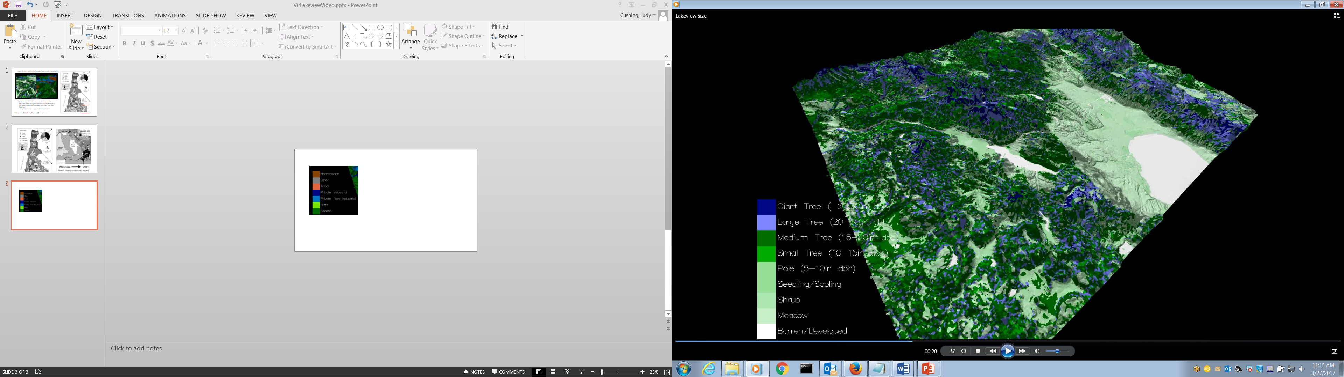
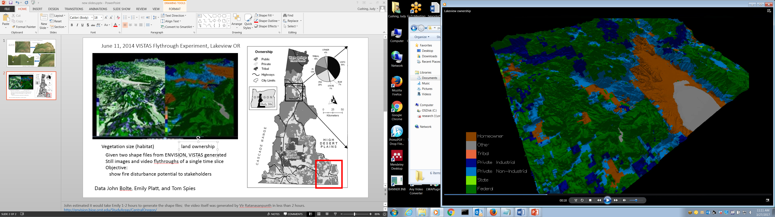
June 11, 2014 VISTAS Flythrough, Lakeview OR
Given two ENVISION shapefiles, VISTAS generated stills and flythroughs of a single time slice, to
show fire disturbance potential to stakeholders
Vegetation size (habitat)
Ownership
Giant Tree (>30” dbh)
Homeowner
Large Tree (20-30” dbh)
Other
Medium Tree (15-20” dbh)
Tribal
Small Tree (10-15” dbh)
Private – Industrial
Pole (5-10” dbh)
Private – Non-Industrial
Seedling/Sapling
State
Shrub
Federal
Meadow
Barren/Developed
Data John Bolte, Emily Platt, and Tom Spies
Notes:
John estimated it would take Emily 1-2 hours to generate the shape files; the video itself was generated by Vir Ratanasanpunth in less than 2 hours. http://envision.bioe.orst.edu/StudyAreas/CentralOregon/
http://envision.bioe.orst.edu/caseStudies.aspx
Central Oregon - Forests, People and Fire
This project focuses on improving our understanding of how biophysical systems, management actions, and socio-economic influences interact to affect sustainability in fire-prone landscapes under climate change. This work integrates social and ecological sciences to study a fire-prone landscape in central Oregon that includes private, state, federal, and tribal lands. We are developing a rich representation of social network influences on actor [sic] decision-making in this landscape, and coupling that with models of vegetation dynamics, fire, and habitat to identify policies and strategies for achieving landscape management goals.

Slide 20
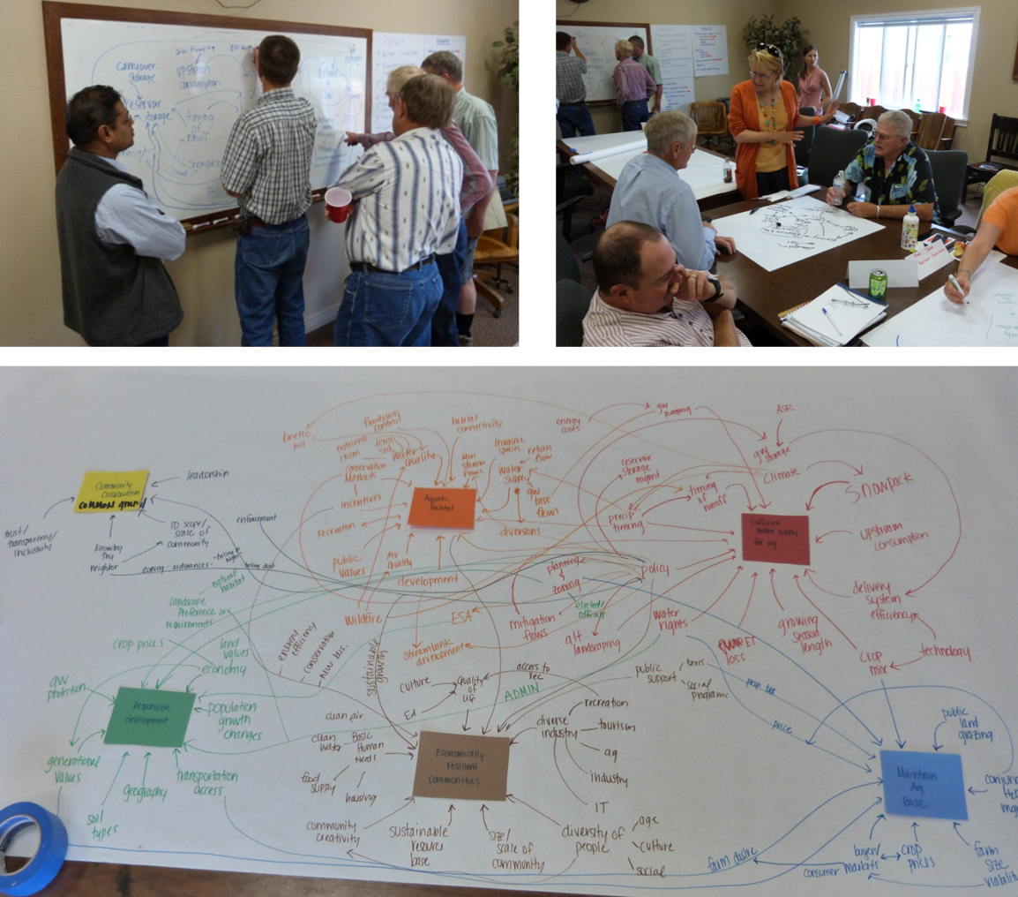
Alternative Land-Use Scenarios Big Wood Basin (Idaho) Co-developing Knowledge

Slide 21
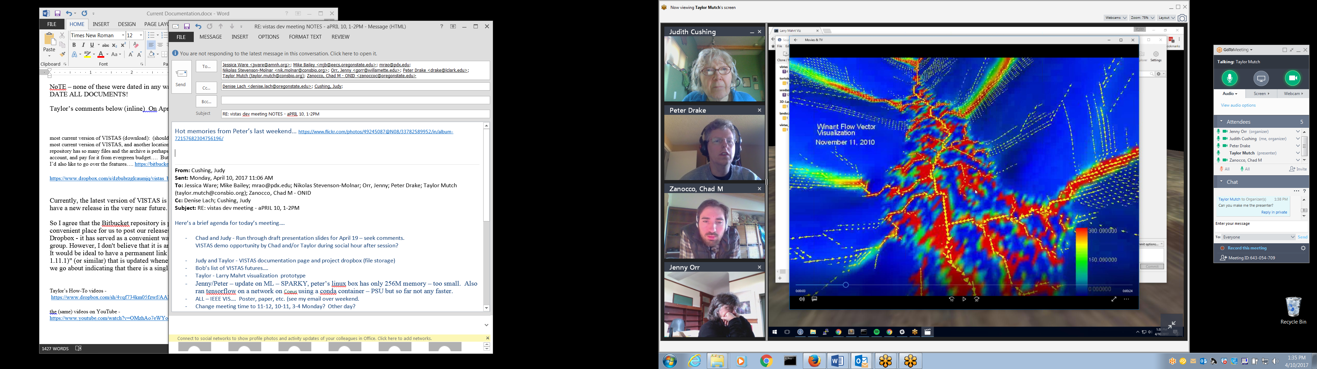
Hydrological-Biogeochemical Processes an Oregon salt marsh
Arrows indicate flow direction
background colors, magnitude of groundwater lateral flow
Soil moisture is predicted by VELMA
water flow by JPDEM (another EPA program) and is based only on topography
Video at: https://www.dropbox.com/s/s5rtf93wx3uewk4/myvectortest.wmv?dl=0
Notes:
an Oregon salt marsh (the flat area in the center of the scene), upland groundwater flowing downhill into the marsh perimeter
inspiration for this water flow vector viz came from wind direction and speed maps, for example, https://www.ventusky.com/.
“Taylor's VISTAS solution captures this concept remarkably well and opens up many potential applications for better understanding real world water quality problems and designing green infrastructure solutions”

